Slide 1

23-24
Budget
The mission of the Santa Cruz County Fire Department is to protect the life, property, and natural resources of its citizens and visitors through effective emergency response, preparedness, education, and prevention.

Slide 2
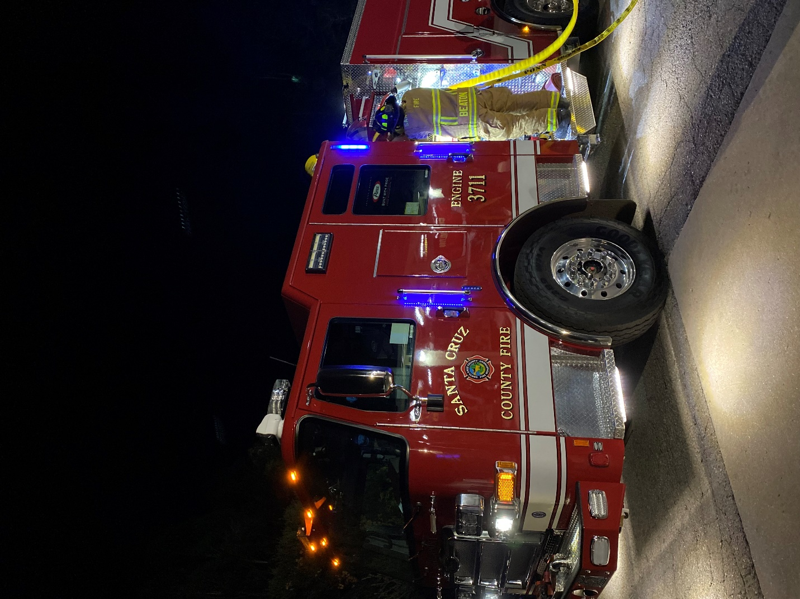
OVERVIEW 23-24
Projected Revenue - $5,799,492
Projected Expenditures - $7,603,854
Difference - $-1,804,362
Projected Balance - $XXXXXXXX

Slide 3
MAJOR CHANGES 23-24
Purchase of Type 1 Engine - $1,000,000
This will replace E2911 or E3211 based on vehicle age. New engines are 40 month turn-around once ordered.
Removal of Contract Savings - $1,326,344
The 23/24 budget does not have the historical built in contract savings, is shows actual cost.

Slide 4
UPDATES
23-24
Reductions of carryovers from previous fiscal years
Fleet Reduction Plan (BC Filson)
AED Replacement Plan (BC Garcia)
Small Tools - Reduction
Fleet Maintenance increase $30K
  Annual Increase
  Below industry cost

Slide 5

QUESTIONS?

