Slide 1

CALFIRE Contract Recommendation
May 3rd 2023
Fire Department Advisory Commission

Slide 2
County has contracted with the State since 1948 for Cooperative Fire Protection of our Community.
Current Agreement 3 years FY 2020-21 to FY 2022-23. (Ends June 30 2023)
  Covers County Service Area 4 Pajaro Dunes
    Community Advisory Group
  Covers County Services Area 48 County Fire
    Fire Department Advisory Committee

Slide 3
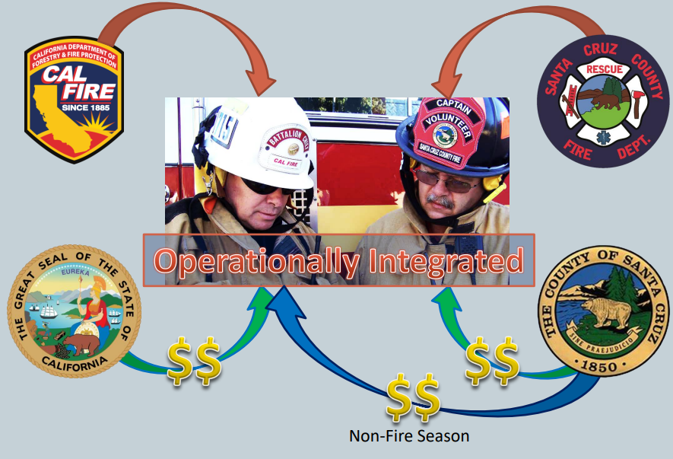
CSA 48 CHARACTERISTICS
286 Sq. MILES
883 ACRES OF PARKS SPACE
710 ACRES OF OPEN SPACES
27 COASTAL ACCESS POINTS
5 PARK STRUCTURES 1 SWIM CENTER
RESPONSE TYPE
2,281 EMERGENCY CALLS
441 FIRE RELATED CALLS
752 MEDICAL EMERGENCIES
277 TRAFFIC COLLISION RESPONSES
811 OTHER TYPE RESPONSE
WHAT IS COUNTY FIRE

Slide 4
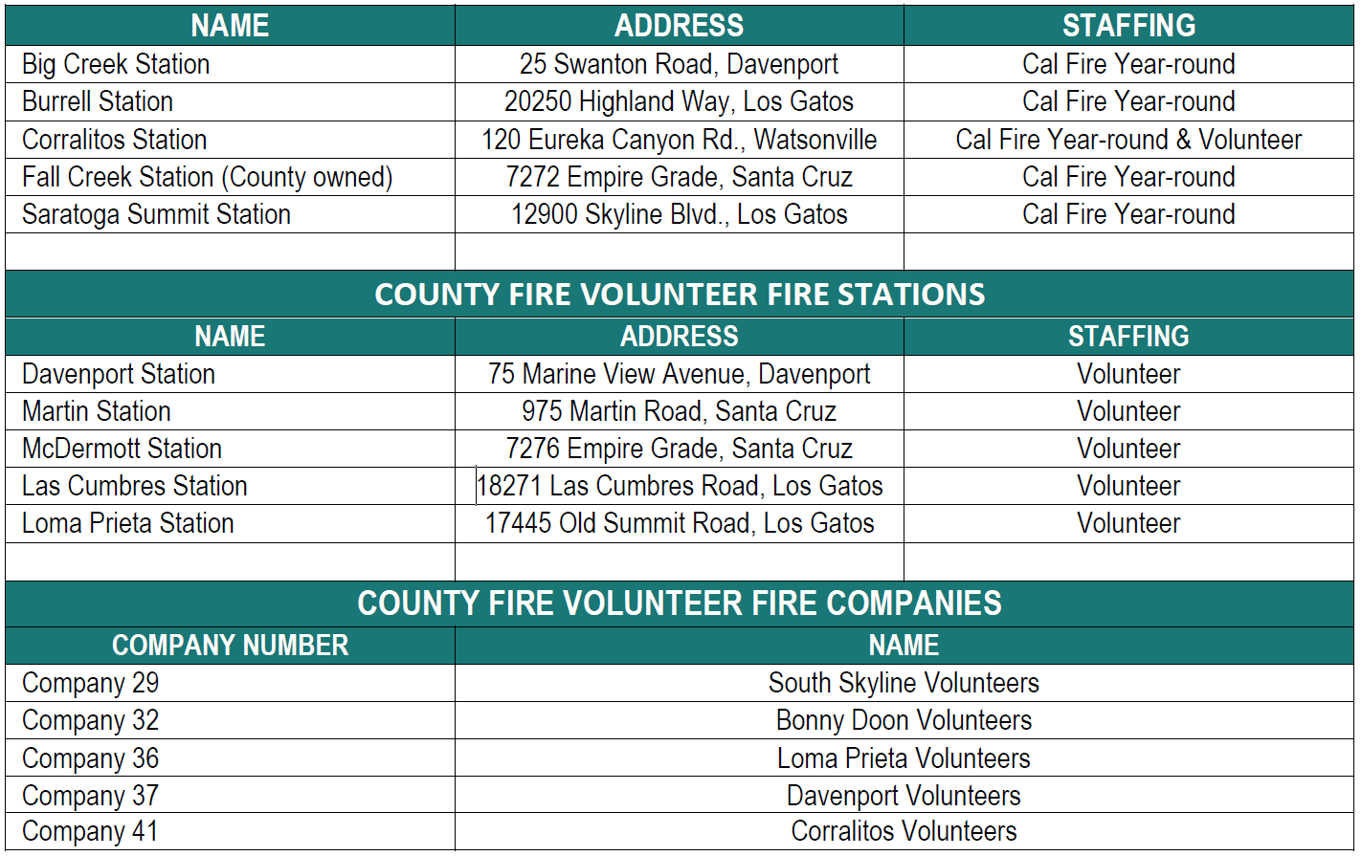
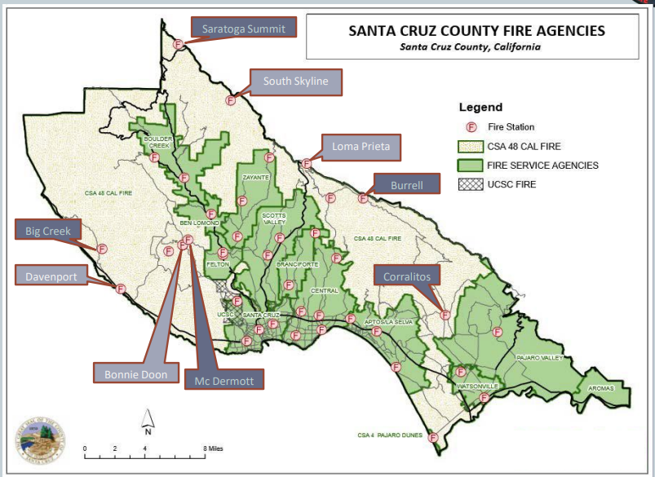
WHERE IS COUNTY FIRE

Slide 5
MISSION
The mission of the Santa Cruz County Fire Department is to protect the life, property, and natural resources of its citizens and visitors through effective emergency response, preparedness, education, and prevention.
VISION
The vision of the Santa Cruz County Fire Department is to provide quality service to all communities in the county and to be a leader in fire protection, fire prevention, and emergency response.

Slide 6
COUNTY CONTRACTS WITH CALFIRE FOR THE PROVISION OF THE FOLLOWING:
Administration of County Fire – COUNTY FIRE CHIEF
Non-Fire Season Emergency Response (7-Months) Amador Period
  5 Fire Stations
Dispatch Services (12 Months)
Fire Code Inspections & Permits (12- Months)
Volunteer Program Oversight (12-Months)
Land Use/Pre-Fire Planning Services (Community Outreach and Education)

Slide 7
CALFIRE CONTRACT CURRENTLY COVERS FY 21-23
Non-Fire Season Emergency Response (7-Months) Amador Period | Volunteer Program Oversight (12-Months)
Emergency Fire Protection, Medical and Rescue Response | 2.0 Fire Captains – Training
Basic Life Support Services (BLS) | Fire and Emergency Medical
2.0 Fire Fighters per Engine Per Day – 24 Total Firefighters - County Funded | Land Use/Pre-Fire Planning Services (Community Outreach and Education)
Dispatch Services (12 Months) | 1.0 Fire Prevention Specialist
Year Round Emergency Dispatch Services | Administrative Staff
1.0 Communications Operator | 1.0 Fire Battalion Chief
Fire Code Inspections & Permits (12- Months) | 2.4 Admin Staff
1.5 Fire Captains

Slide 8
Issues Affecting County Fire
Staffing Challenges
  CALFIRE Staffing Challenges
    Minimum Staffing Mandate
      Mandates 3.0 FTE per Engine Seat (MEMO) Funded by CO-OP Agency (Currently 2.4 FTE)
      July 2024 Fire Fighters negotiated 66 Hour work week (current 72) Potential decrease to 56 Hours.
County Fire Master Plan
  Expected Completion in FY 23-24. (recommended changes)
LAFCO Annexation Potentials
  Corralitos Fire Response Area
  Pajaro Dunes Fire Protection Area
Community Demand for Fuel Reduction – Work
  Grand Jury
Reliance on CALFIRE for Primary Emergency Response

Slide 9
CONTRACT CHANGES RECOMMENDATIONS 1-Year Agreement Only
Non-Fire Season Emergency Response Coverage
  Add 6 positions (Engineers – Drivers) to meet State Minimum Levels
  Decrease County Liability period to 5 month (currently 7 months) $-savings
Dispatch Services – Unchanged
Fire Code Inspections & Permits (12- Months)
  Reduce by 1.0 FTE Captain – (service to be contracted $-savings)
Volunteer Program Oversight – Unchanged
Land Use/Pre-Fire Planning Services
  Convert 1.0 Fire Prevention Specialist to a 1.0 Forestry Assistant II

Slide 10
FY | Stations | BC | FAE | FFI | Prevention FC | Prevention FPS | Training FC | Admin | Dispatch | HEM
2006/07 | 4 |  | 0 | 12 | 2 | 1 | 1 | 2 | 1.5 | 1
2007/08 | 3 |  | 0 | 17 | 2 | 1 | 1 | 2 | 1.5 | 1
2008/09 | 5 |  | 0 | 20 | 1.5 | 1 | 1 | 2.75 | 1.5 | 1
2009/10 | 5 |  | 0 | 19 | 1.5 | 1 | 1 | 2.75 | 1.5 | 1
2010/11 | 5 |  | 0 | 20 | 1.5 | 1 | 1 | 2.75 | 1.5 | 1
2011/12 | 5 |  | 0 | 20 | 1.5 | 1 | 1 | 3 | 1.5 | 1
2012/13 | 5 |  | 0 | 18 | 0.83 | 1 | 1 | 3 | 1.5 | 1
2013/14 | 5 |  | 0 | 18 | 0.5 | 1 | 1 | 3 | 1.5 | 1
2014/15 | 5 |  | 0 | 18 | 0.5 | 1 | 1 | 3 | 1.5 | 1
2015/16 | 5 |  | 0 | 18 | 0.5 | 1 | 1 | 3 | 1.5 | 1
2016/17 | 5 |  | 0 | 18 | 0.5 | 1 | 1 | 3 | 1.5 | 0
2017/18 | 5 |  | 0 | 18 | 1.5 | 1 | 1 | 3 | 1.5 | 0
2018/19 | 5 |  | 0 | 18 | 1.5 | 1 | 1 | 3 | 1.5 | 0
2019/20 | 5 |  | 0 | 18 | 1.5 | 1 | 1 | 3 | 1.5 | 0
2020/21 | 5 |  | 0 | 24 | 1.5 | 1 | 2 | 3.4 | 1 | 0
2021/22 | 5 | 1 | 0 | 24 | 1.5 | 1 | 2 | 2.4 | 1 | 0
2022/23 | 5 | 1 | 0 | 24 | 1.5 | 1 | 2 | 2.4 | 1 | 0
Proposed | 5 | 1 | 6 | 24 | 0.5 | 1 | 2 | 2.4 | 1 | 0

Slide 11
FY | Contract Amt | Invoiced Amt | Cont. Savings | %
2006/07 | $1,770,686 | $1,491,178 | $279,508 | 15.79%
2007/08 | $2,030,354 | $1,622,159 | $408,195 | 20.10%
2008/09 | $2,245,957 | $1,889,783 | $356,174 | 15.86%
2009/10 | $2,447,051 | $1,997,980 | $449,071 | 18.35%
2010/11 | $2,476,995 | $2,079,054 | $397,941 | 16.07%
2011/12 | $2,507,036 | $2,017,976 | $489,060 | 19.51%
2012/13 | $2,462,884 | $1,922,616 | $540,268 | 21.94%
2013/14 | $2,522,951 | $1,551,658 | $971,293 | 38.50%
2014/15 | $2,895,478 | $1,941,095 | $954,383 | 32.96%
2015/16 | $3,040,252 | $1,933,420 | $1,106,832 | 36.41%
2016/17 | $3,192,265 | $2,306,167 | $886,098 | 27.76%
2017/18 | $3,447,549 | $1,713,082 | $1,734,467 | 50.31%
2018/19 | $3,619,927 | $2,062,447 | $1,557,480 | 43.03%
2019/20 | $3,800,923 | $2,120,975 | $1,679,948 | 44.20%
2020/21 | $4,438,279 | $2,228,831 | $2,209,448 | 49.78%
2021/22 | $4,601,954 | $1,311,038 | $3,290,916 | 71.51%
2022/23 | $4,893,203 | $1,438,611 | $3,454,592 | 70.60%
2023/24 | $5,106,408 | $3,319,165 | $1,787,243 | 35.00%
FY 23-24 Projected Contract amount for CSA 48 Services
  Pending State verification of numbers
Average Savings projected to be less in FY 23-24 due to shorter period and 5 additional positions.
FY 23-24 Projected 4.3% increase in contract amount

Slide 12

QUESTIONS

