Slide 1
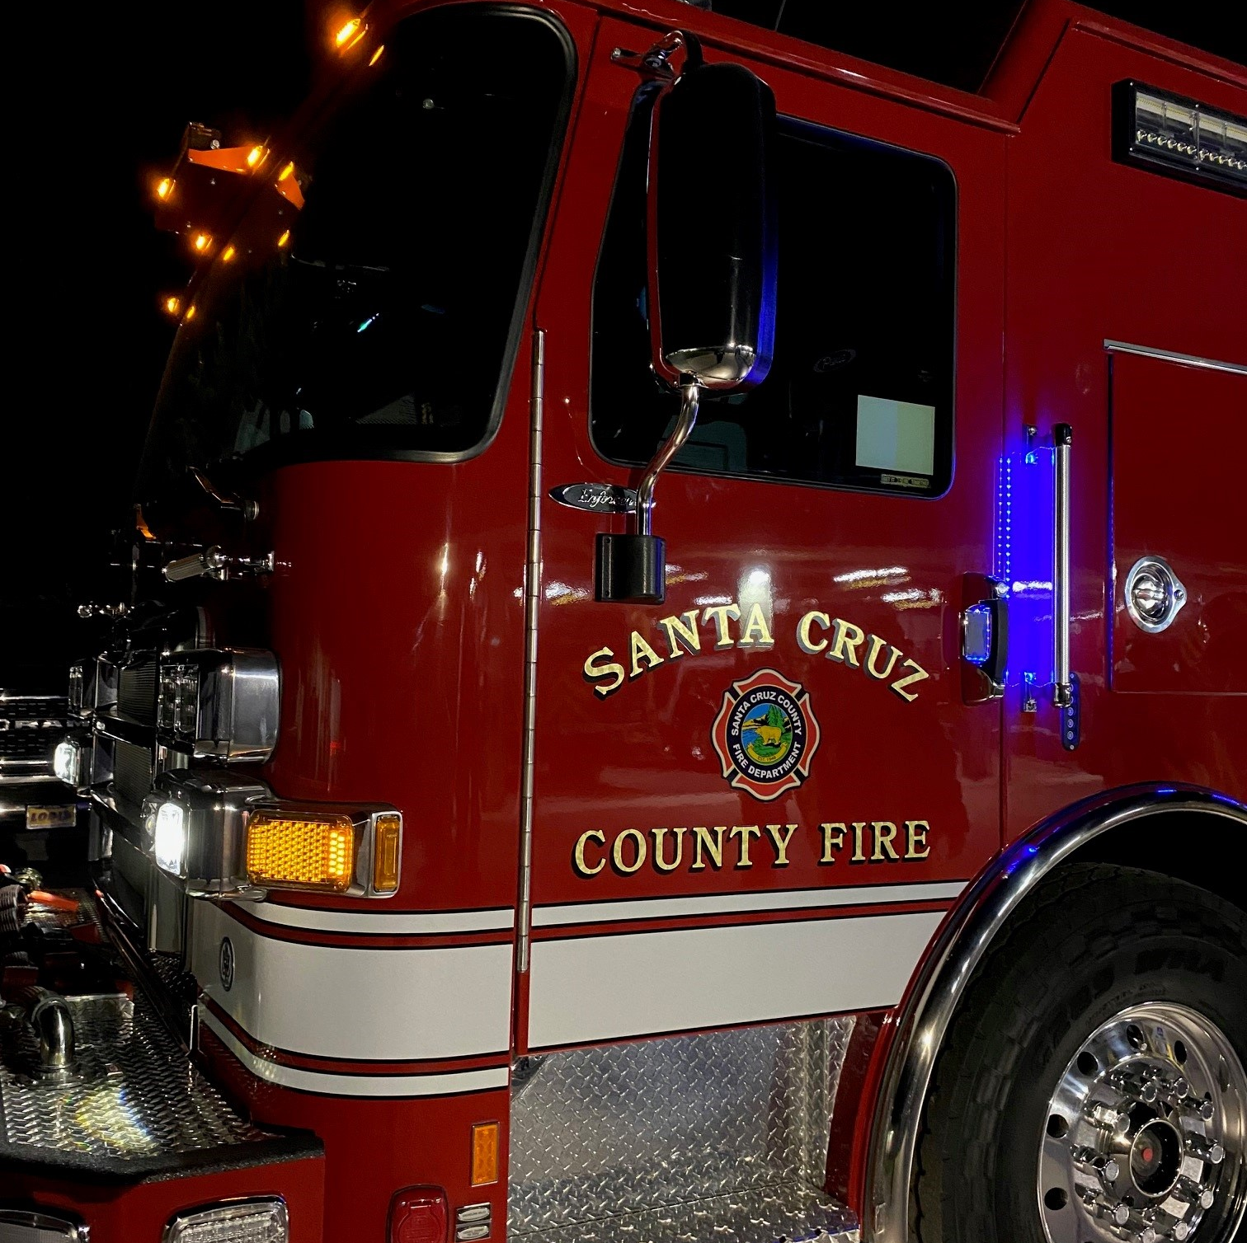

County of Santa Cruz
2023-24 Requested Budget
Fire Department Advisory Commission
Santa Cruz County Fire Protection
May 3, 2023

Slide 2

Prior Year Goals:
Evacuation Maps- System updated
Vegetation Management-Fuels reduced
Volunteer Firefighters-Numbers increased
Fire Surveillance-Surveillance increased
23/24 Goals:
Engage new County Fire volunteer opportunities that do not require emergency response training
Continue to modernize the County Fire fleet to increase efficiency and decrease overall cost
Implement a year-round recruitment and onboarding strategy with the goal of increasing volunteer emergency responders by 10%
Operational Objectives

Slide 3
CALFIRE CONTRACT
Fire Apparatus/Equipment Purchases
Costs to Maintain/Operate Fire Apparatus/Equipment
Costs to Maintain/Operate Fire Stations
Volunteer System Cost and Supports
What's in County Fire Budget

Slide 4
 | Description | 2020-21 Actuals | 2021-22 Actuals | 2022/23 Final Budget (Allow) | 2022/23 ESTIMATED ACTUALS | 2023/24 REQUEST
51000 | Regular Pay - Permanent | 0 | 1,352 | 0 | 11,369 | 0
51010 | Regular Pay - Extra Help | 73,066 | 50,207 | 102,500 | 60,000 | 102,500
51040 | Differential Pay | 0 | 68 | 0 | 568 | 0
52010 | OASDI - Social Security | 0 | 106 | 0 | 484 | 0
52015 | PERS | 0 | 391 | 0 | 3,408 | 0
53010 | Employee Ins & Benefits | 0 | 171 | 0 | 1,320 | 0
54010 | Workers Comp Ins | 64,485 | 46,957 | 80,678 | 51,432 | 62,036
 | Total Staff Costs | 137,551 | 99,252 | 183,178 | 128,581 | 164,536
Volunteer Stipends
What's in County Fire Budget
Volunteer Workers Comp
Salaries and Benefits Category

Slide 5
Volunteer Turnouts/PPE
Phones & Cradlepoints
Commercial Liability Ins
 | Description | 2020-21 Actuals | 2021-22 Actuals | 2022/23 Final Budget (Allow) | 2022/23 ESTIMATED ACTUALS | 2023/24 REQUEST
61110 | Clothing | 13,132 | 33,620 | 141,147 | 127,714 | 48,800
61215 | Radio | 2,425 | 6,623 | 20,000 | 20,000 | 20,000
61220 | Telephone | (70) | 746 | 0 | 0 | 0
61221 | Telephone-non telecom | 9,877 | 27,745 | 46,000 | 19,356 | 46,000
61425 | Other Household Expenses | 1,017 | 2,545 | 8,200 | 8,200 | 12,000
61535 | Other Ins. | 56,524 | 41,959 | 62,189 | 62,189 | 64,217
61720 | Maint.-Mobile Equipment Services | 150,092 | 125,554 | 159,320 | 109,320 | 190,000
61840 | Facilities - Maint-Plumbing-Serv | 0 | 0 | 0 | 0 | 0
61845 | Maintenance - Structure | 38,577 | 34,230 | 266,916 | 183,938 | 107,829
61920 | Medical, Dental, Lab Supplies | 40,446 | 44,109 | 116,872 | 100,000 | 58,500
62020 | Memberships | 336 | 334 | 2,825 | 2,825 | 2,825
62214 | Duplicating Services | 0 | 0 | 200 | 200 | 200
62219 | PC Software | 2,913 | 23,591 | 75,428 | 75,428 | 75,428
62221 | Postage | 9 | (1) | 50 | 50 | 50
62222 | Subscriptions/Periodicals | 0 | 0 | 50 | 50 | 0
62223 | Supplies | 6,983 | 5,575 | 8,000 | 8,000 | 8,500
62226 | Inventoriable Items | 134,782 | 622,672 | 129,395 | 100,806 | 80,000
Apparatus Repairs/Maint
Maint/repairs Stations
What's in County Fire Budget
Medical and AED’s
Tablet Command/Records Mgt
New Radios
Services and Supplies Category

Slide 6
ACTTC Charges
 | Description | 2020-21 Actuals | 2021-22 Actuals | 2022/23 Final Budget (Allow) | 2022/23 ESTIMATED ACTUALS | 2023/24 REQUEST
62301 | Acct/Auditing Fees | 21,072 | 17,793 | 28,370 | 28,370 | 41,500
62325 | ISD - Data Proc. | 8,756 | 19,862 | 13,839 | 13,839 | 15,311
62349 | GIS Services | 0 | 0 | 0 | 0 | 0
62365 | Management Services | 2,744 | 6,307 | 0 | 0 | 0
62366 | Medical Services | 45,603 | 4,407 | 49,613 | 40,000 | 64,550
62376 | Planning Services | 175 | 175 | 0 | 0 | 0
62381 | Professional Services | 2,270,710 | 1,372,215 | 6,387,090 | 1,438,611 | 4,620,046
62420 | Legal Notices | 0 | 1,171 | 800 | 800 | 800
62715 | Small Tools | 167,981 | 76,675 | 319,725 | 319,000 | 137,310
62801 | Advertising & Promotion | 0 | 0 | 0 | 0 | 0
62855 | Management | 11,203 | 0 | 36,356 | 36,356 | 53,542
62856 | Special Misc. Expense | 18,835 | 14,685 | 49,550 | 40,000 | 30,150
Volunteer Physicals/Med
CALFIRE CONT $4.53M
Paradise Park
Aptos Hills
Other
What's in County Fire Budget
Tablet Command/Records Mgt
SCBA Bottle Filler – Fire Prevention Programs
New Radios
Services and Supplies Category

Slide 7
New Fire Hose $95K
Hose Testing $20K
Rope Replacement $50K
SCBA Maintenance $25K
Extrication Tools $15K
 | Description | 2020-21 Actuals | 2021-22 Actuals | 2022/23 Final Budget (Allow) | 2022/23 ESTIMATED ACTUALS | 2023/24 REQUEST
62888 | Special Dist. Expense | 50,466 | 51,287 | 245,898 | 220,000 | 222,284
62890 | Subscriptions | 371 | 56 | 130 | 130 | 70
62914 | Training | 15,656 | 10,646 | 57,815 | 32,473 | 50,820
62920 | Gas, Oil, Fuel | 7,250 | 6,977 | 11,500 | 10,000 | 11,500
62926 | Mileage | 0 | 0 | 0 | 0 | 0
62928 | Travel/Mileage | 33 | 0 | 0 | 0 | 0
62935 | Service Center Charges | 18,509 | 13,263 | 13,300 | 13,000 | 14,000
62936 | Replacement Reserve | 160 | 600 | 600 | 600 | 600
62937 | Depreciation | 5,101 | 0 | 5,172 | 5,172 | 5,172
63070 | Utilities | 34,409 | 31,088 | 34,300 | 25,000 | 30,300
Learning Management Platform
EMT CERTS
CPAT
State Fire Marshall
What's in County Fire Budget
County Fleet Charges
Electrical, Water, Sewer
Services and Supplies Category

Slide 8
SCHMIT TEAM (HAZMAT)
RE-Insulaltion Fire Station
 | Description | 2020-21 Actuals | 2021-22 Actuals | 2022/23 Final Budget (Allow) | 2022/23 ESTIMATED ACTUALS | 2023/24 REQUEST
74850 | Taxes and Licenses | 3,503 | 60 | 10 | 10 | 10
75230 | Contributions to other agcy | 29,305 | 33,701 | 35,050 | 35,050 | 40,000
75315 | County Overhead | 53,733 | 80,020 | 24,004 | 80,020 | 24,004
86110 | Buildings & Improvements | 90,031 | 171,560 | 121,232 | 205,680 | 20,000
86204 | Equipment | 274,323 | 143,584 | 184,244 | 168,060 | 18,000
86209 | Mobile Equipment | 0 | 86,209 | 2,144,849 | 879,814 | 1,125,000
98700 | Contingencies | 0 | 0 | 200,000 | 0 | 200,000
Radio Base Station & Speakers
What's in County Fire Budget
Replace 3211 Type 1 $1M
Rescue Vehicle Upfit $15K
Taxes for 3 Engines on Order $90K
Training Capt Vehicle
$20K
Other Charges

Slide 9
Property Taxes average 6.372% of 1% assessed
Interest on Fund Balance
 | Description | 2020-21 Actuals | 2021-22 Actuals | 2022/23 Final Budget (Allow) | 2022/23 ESTIMATED ACTUALS | 2023/24 REQUEST
 | Prior Year End Fund Balance | 6,157,904 | 8,815,294 | 11,252,513 | 11,252,513 | 12,409,107
40100 | Property Tax-current-sec | 2,505,026 | 2,528,912 | 2,672,702 | 2,569,906 | 2,698,401
40110 | Property Tax-current-unsec | 42,637 | 46,931 | 47,152 | 49,662 | 52,145
40130 | Property Tax-prior unsec | 8,928 | 5,443 | 4,848 | 1,909 | 4,000
40150 | Supplemental prop tax cs | 22,211 | 65,239 | 34,055 | 19,168 | 30,000
40151 | Supplemental prop tax-cu | 979 | 812 | 0 | 1,040 | 0
40160 | Supp prop tax-prior secured | 2,620 | 1,058 | 1,747 | 2,580 | 1,700
40161 | Prior year nsec supp apport | 402 | 461 | 565 | 317 | 400
40192 | Assessments | 3,121 | (3,121) | 0 | 0 | 0
40197 | In-Lieu Taxes Other | 1,140 | 1,168 | 0 | 0 | 0
40430 | Interest | 48,539 | 42,139 | 77,370 | 96,473 | 80,000
40830 | St-Homeowners' prop. tax | 13,403 | 13,201 | 13,597 | 12,973 | 13,100
40852 | St-other tax relief subvent. | 1,315 | 1,491 | 1,000 | 841 | 1,000
40899 | St-Prior Year Adjustments | 0 | 0 | 0 | 0 | 0
41095 | FED-Other Misc Grants | 44,655 | (1,175) | 74,000 | 8,975 | 10,000
41163 | AID Other Gov Anti-Terr Appr Auth | 0 | 0 | 0 | 0 | 0
41304 | Inspection charges | 22,610 | 11,839 | 20,000 | 19,719 | 20,000
41576 | Permit Processing Fees | 39,114 | 17,457 | 25,000 | 9,628 | 15,000
42022 | Cost Recovery-other | 877,958 | 245,424 | 60,000 | 218,467 | 60,000
42030 | Fire Protection Services | 2,746,251 | 2,669,902 | 2,763,678 | 2,666,071 | 2,813,746
 | Total Revenue | 6,381,925 | 5,648,114 | 5,795,714 | 5,695,236 | 5,799,492
Building Plans Reviews
What Funds County Fire
State Use of Equipment Type 1 ($3,407 per day)
Type 3- ($3,078 per day)
CSA 48 SBA
$1.274M
CSA 48 2020
S1.539M
Revenue

Slide 10
Description | 2020-21 Actuals | 2021-22 Actuals | 2022/23 Final Budget (Allow) | 2022/23 ESTIMATED ACTUALS | 2023/24 REQUEST
TOTAL REVENUES | 6,381,925 | 5,648,114 | 5,795,714 | 5,695,236 | 5,799,492
TOTAL EXPENDITURES | 3,724,523 | 3,210,895 | 9,920,032 | 4,538,642 | 7,603,854
Difference | 2,657,402 | 2,437,219 | (4,124,318) | 1,156,594 | (1,804,362)
Overall County Fire Budget

Slide 11
Description | 2013/2014 Actuals | 2014/15 Actuals | 2015/16 Actuals | 2016-17 Actuals | 2017-18 Actuals | 2018-19 Actuals | 2019-20 Actuals | 2020-21 Actuals | 2021-22 Actuals | 2022/23 ESTIMATED ACTUALS
COUNTY FIRE FUND END BALANCE | 3,145,359 | 4,100,729 | 4,150,150 | 3,509,609 | 4,722,410 | 5,463,511 | 6,157,904 | 8,815,294 | 10,006,504 | 12,409,107
County Fire FUND BALANCE

Slide 12
Future Considerations
Long-term Opportunities & Risks
Opportunities
  Grant Funding for personnel costs
  Longer fire seasons
  Increased transfers-in due to CAL FIRE use of County Fire equipment
Risks
  Increased labor contract costs
  Longer fire seasons
  Increased fuel reduction demands
  Increased public demand for services
Notes:
Conclude with any other future opportunities, impacts or considerations (the SmartArt is provided as a tool but you can choose to present in another way).
For example, from your department Budget Submission Tool (Narrative-Internal tab), describe any changes beyond funding that need to occur to be successful?
What County and non-County partners need to be activated?
What County systems or workflows need to be amended?
What impact might these changes have on other positions/programs?
For future facility or software system needs, discuss:
What is it used for
Why is it important in the next few years
Any internal planning that may be underway
Any total project costs (rough/best estimates are fine)

